Slide 1
Arduino Techniques: Interrupts
Michael Benson
February 9, 2019

Slide 2
Lecture Overview
Who I Am
Interrupt Principles
External Interrupts
Software Interrupts
Arduino Implementation
Applications to MATE ROV Competition
Examples
Resources

Slide 3
Who am I?
BSME ‘15, VU
Minor: Mechatronics
PhD Engineering, Ongoing, VU
Research areas:
Vision and depth sensing
Robot perception & autonomy
Research projects:
Roboboat & RobotX
Low-cost Explosive Ordnance Disposal Robot
Rugged outdoor mine detection robot

Slide 4
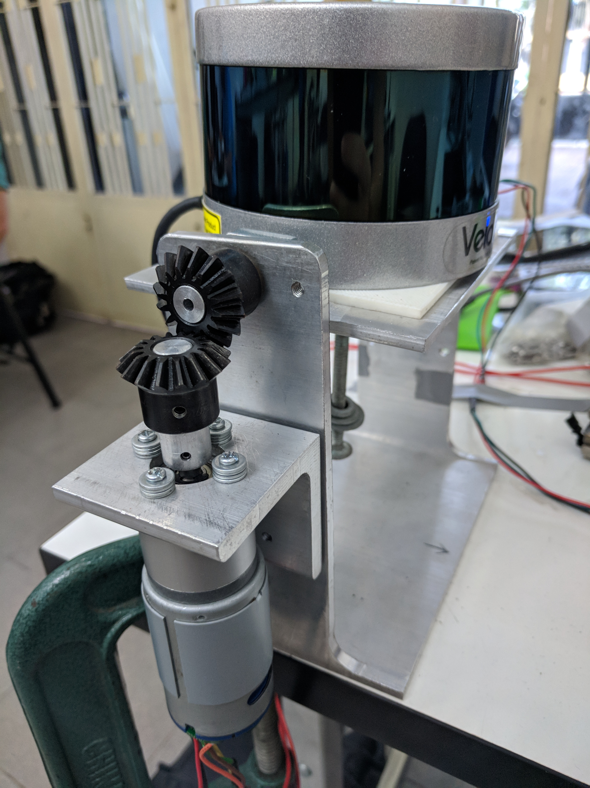


Who am I?

Slide 5
Motivating Interrupts
When programs are short, it’s easy to poll sensors and control actuators in Loop()
As programs do more, this method becomes less effective
Can miss a quick press of a button or a short signal from a sensor
Actuator feedback control can become unstable if time is too irregular!
Need some way to handle certain input and time events

Slide 6
What is an Interrupt?
An interrupt is a signal to the processor indicating an event that requires immediate attention
Processor responds by:
Suspending what it’s doing
Executing a function (interrupt handler or interrupt service routine (ISR))
Resuming where it left off
We can control what causes an interrupt and what the function is!

Slide 7
Types of Interrupts
Hardware interrupts are triggered by an external device
Typically from a pin change
Pressing a button
Signal from motor encoder
Optical switch/photointerruptor
Can also be from communication (e.g. Serial)
Software interrupts are triggered by an internal exception
Typically a timer interrupt
Controlling motors & actuators
Polling inputs & sensors
Can also be from events like division by 0

Slide 8
Pin Modes
Hardware interrupts triggered pin changes have different modes you can specify:
LOW: triggers whenever the pin is low
CHANGE: triggers whenever the pin changes value
RISING: triggers when the pin goes from low to high
FALLING: triggers when the pin goes from high to low
HIGH: triggers whenever the pin is high (only on select Arduino boards)

Slide 9
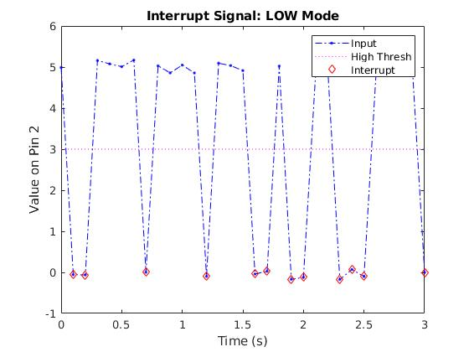
Example: LOW Mode

Slide 10
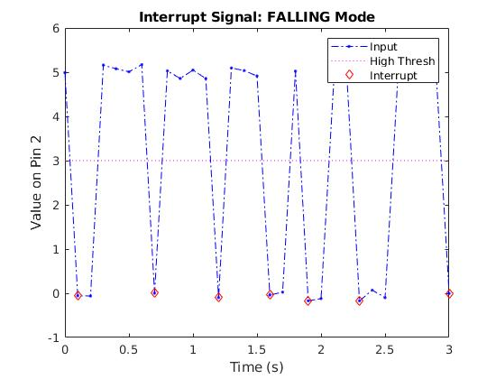
Example: FALLING Mode

Slide 11
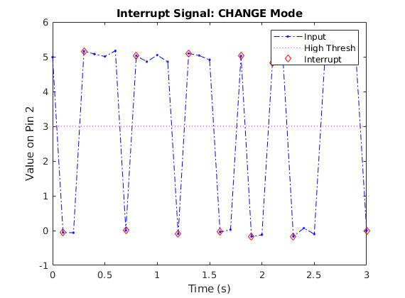
Example: CHANGE Mode

Slide 12
Arduino HowTo: Pin Interrupts
Arduino has made it quite simple to set up pin interrupts!
Requires one line to setup the interrupt:
attachInterrupt(digitalPinToInterrupt(pin), ISR, mode);
where:
pin is the digital pin we are using
ISR is the function called (must have no inputs and no returns)
mode is the pin mode as we just discussed
Note: only certain pins are usable, depending on your board. See: https://www.arduino.cc/reference/en/language/functions/external-interrupts/attachinterrupt/

Slide 13
Arduino HowTo: Timer Interrupts
Unfortunately, this gets a bit more tricky…
Directly manipulating registers
Register names/addresses vary by board!
Calculating premultipliers
We’re not going to do this, but if you feel up to a challenge:
This is the tutorial I learned on: https://www.robotshop.com/community/forum/t/arduino-101-timers-and-interrupts/13072
Also will need to consult datasheet for the appropriate processor. Here’s the one for the Uno: https://www.sparkfun.com/datasheets/Components/SMD/ATMega328.pdf

Slide 14
Arduino HowTo: Timer Interrupts
Arduino now offers a downloadable library that works with most boards, including the Uno: https://playground.arduino.cc/code/timer1
Requires a few more lines to set up:
Timer1.initialize(period);
Timer1.attachInterrupt(function);
where:
period is the number of microseconds between calls
function is the function to be called

Slide 15
Applications to MATE: Pin Interrupts
Actuator emergency stop
Either:
Toggle (press once to disable, again to re-enable)
Hold (disable upon press, re-enable upon release)
Action buttons
Initiate gripper open/close
Obtain sensor measurement

Slide 16
Applications to MATE: Timer Interrupts
Poll sensors at fixed rate
Temperature sensor
Feedback from gripper
Software “limit switch”
Feedback control of actuators (if hardware allows)
Speed control of thrusters

Slide 17
Example: Motor FB Control w/ e-stop
Timer interrupt performing speed control of motor
Pin interrupt on Pin D2 reading encoders
Pin interrupt on Pin D3 acts as e-stop
Extra buttons for controlling speed
Show code & pass around hardware

Slide 18
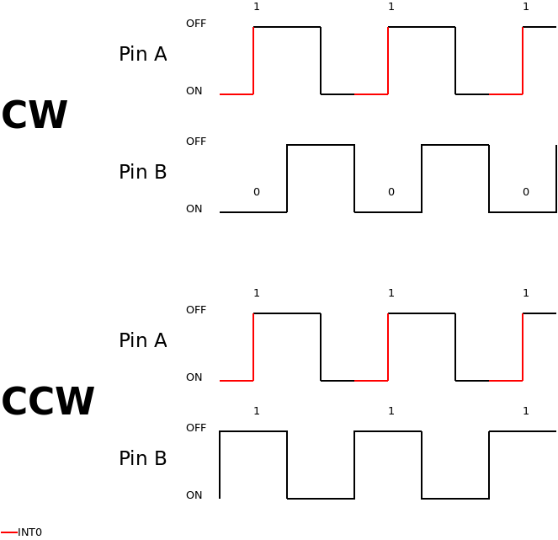
Encoders
http://www.leniwiec.org/wp-content/uploads/2014/04/rysunek_2.png

Slide 19
Some Notes
The functions called by interrupts are meant to be very short:
No long routines
delay(), millis(), etc. may not behave as expected
Any variables that are changed within interrupt functions must be declared as volatile
Be very careful about what goes on in Loop(), what goes on in functions, and any variables used in both!
Think about what can happen if variable changes in value halfway through Loop(), etc.

Slide 20
Resources
My email: michael.benson@protonmail.com
This lecture (and my introductory Arduino lecture): https://github.com/mbenson182/ArduinoLectures
Arduino reference: https://www.arduino.cc/reference/en/
Sites like StackOverflow, Sparkfun, etc. are your friend!

